Slide 1
Intro to git / github.com
Version control and code sharing
Terence Parr
MSDS program University of San Francisco

Slide 2
What is git?
Git is a version control system that tracks changes to files and directories within a repository
A repository is just a directory subtree containing files and, optionally, directories that we tell git to treat as a repository
Git allows multiple people to operate on two different copies of the repository without getting confused or losing changes
Workers push/pull changes from a repo on one machine to a repo on a collaborator’s machine
Git is a program that runs on your laptop

Slide 3
What is github.com?
Github.com is a website that hosts repositories, making collaboration much easier
A web interface to your repo files
A free backup!
Note: git != github.com
git is program
github is a web site/server
For our purposes, we’ll ignore the advanced capabilities, such as branching and merging (master/main/...)
See github learning resources

Slide 4
Motivation
Every commercial developer uses version control at work
Every company you encounter uses it
For that reason alone, you need to learn version control to be functional in a commercial setting, such as your practicum
In this class and future classes, you will also use version control to submit your work

Slide 5
An analogy to backup systems
If your laptop is stolen, we will be sympathetic but not excuse missing projects
github doubles as a backup
but I recommend you also get backblaze to keep off-site backups of your disk
Personally, I also have a local Timemachine OS X backup drive sitting next to my computer that takes a snapshot every hour
Using this multi-tiered backup strategy is a good way to think about how programmers use version control
git is kind of like Time Machine, a local backup (that tracks changes)
github.com is kind of like the off-site backblaze cloud-based backup
A difference between git and a backup system is that we tell git when to take a snapshot
Each snapshot should be a logical chunk of work done to your files

Slide 6
Repositories (Repos)
Not only do we have to tell git when to take a snapshot, we also tell it which files to pay attention to (in the repo directory)
The set of files to track is called a repository and at any given time, my computer has lots and lots of these repositories
All files associated with a repo sit somewhere in or below a directory
Each project you work on will be in a separate directory/repo
A git repository instance is just a directory but it also has a .git (hidden) subdirectory, with a database of all changes
To remove a repo, just rm the whole repo directory; there is no central server to notify (this would not delete repo from github.com)

Slide 7
Committing changes
As with the Time Machine backup, git tracks snapshots as the difference from the last time you requested a snapshot
Each snapshot is called a commit (and programmers think of these commits as transactions)
Perform a commit to lock in a logical chunk of work, such as the addition of a feature or fixing of a bug
Warning: always use the "-a" option on the git commit command

Slide 8
Commit log (history)
Having a complete list of changes is extremely useful
We can revert those change sets later
We can discover who created or when a bug was introduced
Can temporarily reset your repository to a moment in time

Slide 9
Cloning from, pushing to github
Continuing with the analogy now, github.com is like the off-site cloud-based backup
Each repo you mirror at github is like a free backup
We’ll likely create a repo using a web interface at github then clone that repo to an (initially empty) directory on our laptops
As with committing changes, we also have to specifically push changes made to the local repository back to github
Every push ensures that the complete file set and git change database (in .git subdirectory) is mirrored at github

Slide 10
Collaboration
I can access your repos mirrored on github, whereas I have no access to your laptop drive
To grade projects, I will clone your repository onto my disk
If you make changes, I can pull those in after you commit/push
I can make comments and then push back to your github repo, which you can then pull down to your laptop
This is how multiple programmers communicate, and how I share work between my USF and home machines

Slide 11
Key commands summary
I recommend using a git GUI like fork in practice, but we’ll use the command line to learn the actual operations and sequence
git clone github_url
git add file_or_dir
git commit -a -m ‘commit message’
git status
git push origin main (main could be called master)
git pull origin main
git rm filename
git mv from_filename to_filename
git reset --hard HEAD
git checkout – filename

Slide 12
Connecting to github via SSH
Naturally you use the website with a username and password
But to remotely access github repositories from the command line or tools such as fork, we need a secure mechanism to identify ourselves to github
See the link below; most of you will not have SSH keys yet so follow “Generating a new SSH key and adding it to the ssh-agent” ssh-keygen -t ed25519 -C your_email@example.com
Press “ENTER” to get all of the defaults; it creates files like: id_rsa and id_rsa.pub (or id_ed25519.pub) in ~/.ssh dir
https://docs.github.com/en/github/authenticating-to-github/connecting-to-github-with-ssh

Slide 13
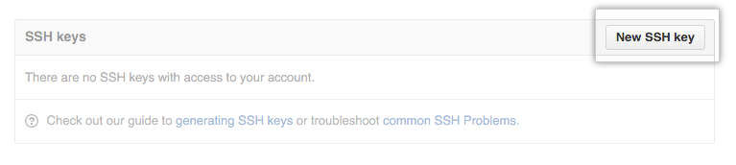
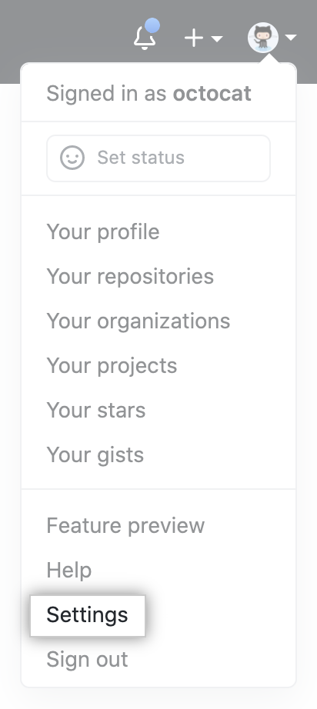
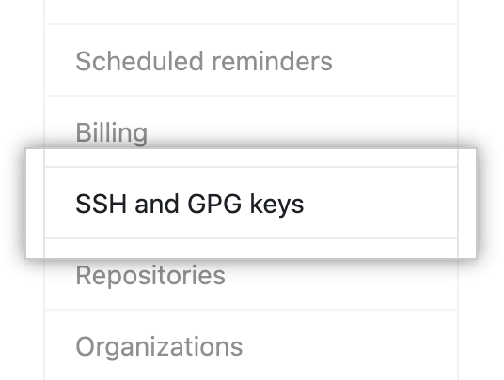
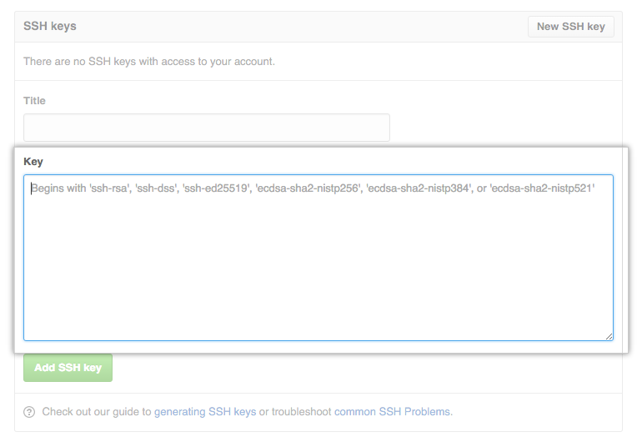
Adding your key to github.com
Copy (cmd-C) contents of file id_rsa.pub (or similar); then at github navigate here:
Paste (cmd-V) here

Slide 14
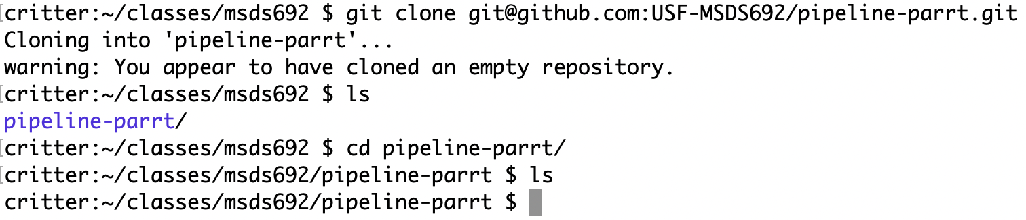
Typical startup sequence
Click on the invitation URL sent to you by instructor to create a repository, which creates repo at github: https://github.com/USF-MSDS692/pipeline-parrt
Get the repo spec from github, which looks similar to repo's github web page URL: git@github.com:USF-MSDS692/pipeline-parrt.git
Clone that (empty) repo onto your laptop from command line:

Slide 15
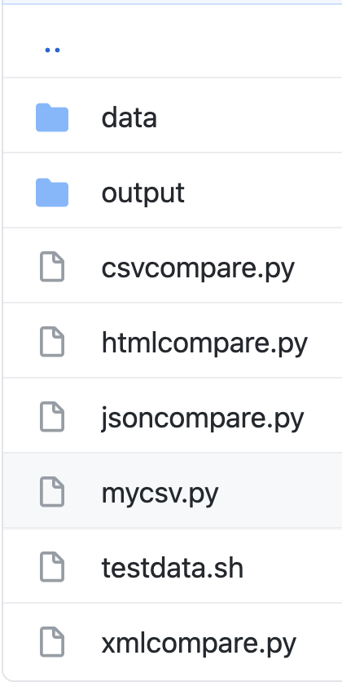
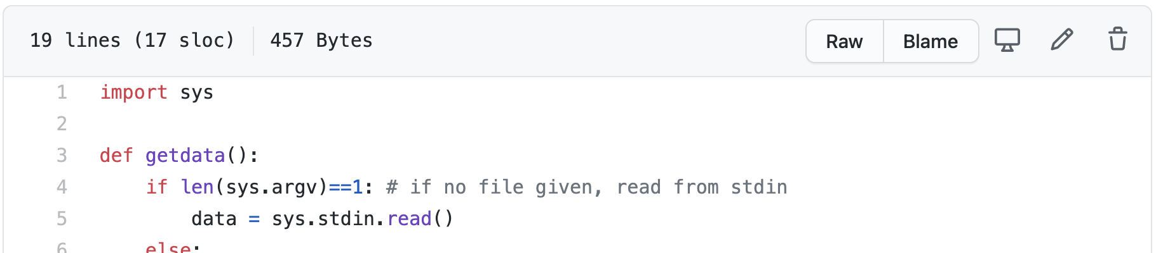
Getting an initial file into your repo
In the directory created during cloning, you will create and edit files associated with the repository
Let's download a starter kit file for this project; Click on mycsv.py and then right click Raw and “Save as…” into your repo directory pipeline-parrt
Starter kit: https://github.com/parrt/msds692/tree/master/hw/code/pipeline

Slide 16
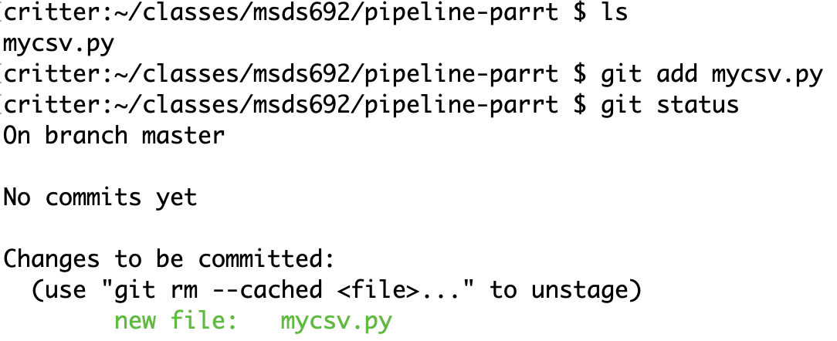
Adding files to the repo
git ignores files unless we tell ask it to pay attention; it's not enough just to put files into the repository directory
“git add” the files of interest so git knows to manage them
Check status; git now sees files

Slide 17
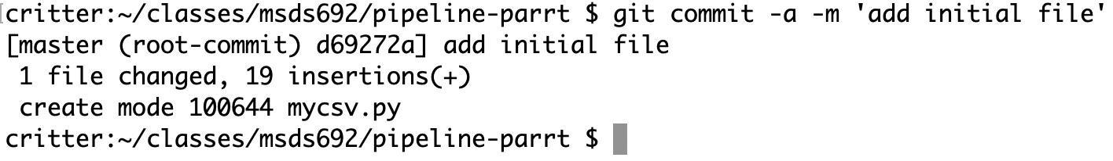
Commit a transaction
Commit tells git to take a snapshot and record it in its log of changes
Additions, deletions, renamings are all considered (reversible) changes
Use a decent commit message and don't forget the "-a" argument which means "do what this command should do by default"

Slide 18
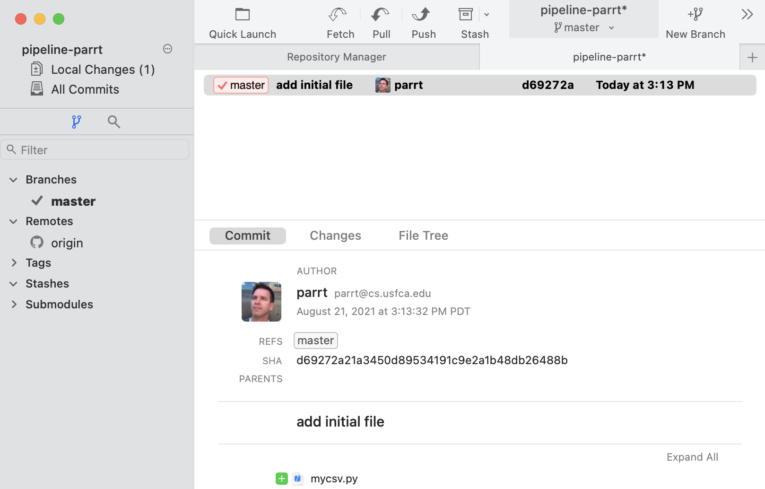
The fork GUI view
There is only one commit but you can see the commit message and the files involved in the transaction
You can also see the origin remote repository is connected because it's listed in the left gutter
Download fork here: https://git-fork.com/

Slide 19
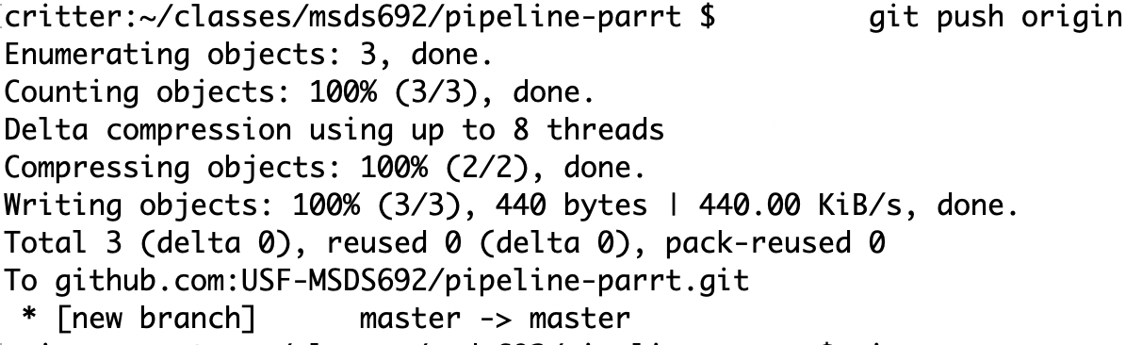
Push to github to mirror repo
Github does not know about your changes unless you explicitly push after committing
We're ignoring branches but we need to know what the main branch is called; it's either master or main (master is the legacy name)

Slide 20
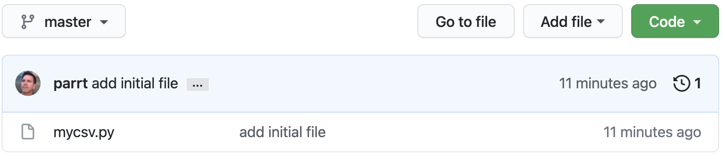
Check github webpage for your repo
Github repo page should show your new file

Slide 21
Initial add/commit sequence summary
Clone repo from github to a directory with same name on laptop
Copy or create files in repository directory
Add those files
Commit those changes (add/edit/delete are all changes)
Push back to the origin (github.com)

Slide 22
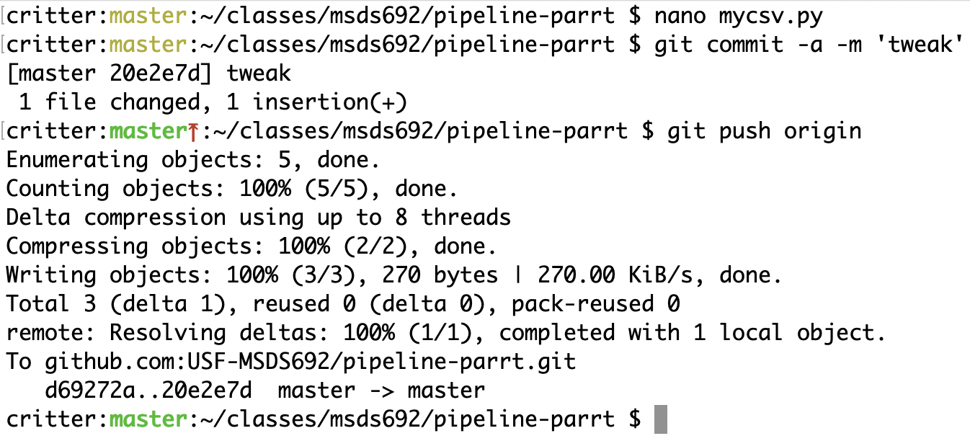
Making edits, mirroring on github
During the normal course of software development, you will edit files and then commit these changes, pushing to github
Here, I'm editing an Python file

Slide 23
Pull in changes from github
If there are changes pushed to github that you do not have in your laptop copy, you must pull in those changes with: git pull origin main (or just git pull)
This happens when I have cloned and added grading results to your repository and pushed them back, or you are working with a partner on a project; both of you push/pull via same github repo

Slide 24
Miscellaneous but useful commands
git rm filename Remove a file from the directory and from git repo tracking
git mv from_filename to_filename Rename a file or directory managed by git
git reset --hard HEAD Wipe out any changes you've made to managed files, resetting the repository to the most recent commit
git checkout -- filename Undo changes made to a single file managed by git, resetting to the state of that file at the most recent commit

Slide 25
Configuring username/email the first time
The first time you try to push something back to github, I think the use of git from the command line will ask you to configure your name and email address using the "git config" command with a bunch of options
Or, it looks like you can do this from github's webpages; see https://docs.github.com/en/github/setting-up-and-managing-your-github-user-account/managing-email-preferences/setting-your-commit-email-address
That might be easier because the command line will ask you to use vi or some other editor you are unfamiliar with

Slide 26
Warnings and recommendations
git is ridiculously complicated and has a terrible interface in my opinion so proceed with caution, but it is the most commonly used!
I recommend sticking with a few commands: clone/add/commit/push/pull/rm/mv
Do NOT do branching/merging until you are much more comfortable with git and version control systems
Anything beyond these simple commands, I avoid or use very carefully after reading the manual

Slide 27
Pitfalls
Repo should be https://github.com/USF-MSDS692/pipeline-youruser NOT https://github.com/youruser/pipeline-youruser
Don’t change your github username and expect me to notice
Github is not a homework submission mechanism; you should be using it from the start of the project:
Clone and add your initial files to get started
As you finish a logical chunk of work, commit and push to github

Slide 28
Even more pitfalls
Don’t use the github website to add/change, at least until you have more experience; too easy to get out of sync with your laptop
Make sure that the github website reflects the contents of your laptop repository at the project due date
Don’t put your project X code into the repository for Y; each project has its own repository
Don’t create random subdirectories in your repository; for our purposes, you will be creating all files in the root of your repository directory

